Slide 1

UNIVERSITY INSTITUTE OF ENGINEERING
COMPUTER SCIENCE ENGINEERING
Computer Vision (CST-422)
Prepared By : Payal Thakur(E12720)
Topic: Detecting Objects: Introduction to Object Tracking, Motion Detection. Detecting Objects with Pretrained Models
DISCOVER . LEARN . EMPOWER

Slide 2
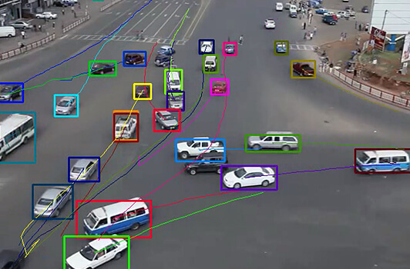
Object Tracking

Slide 3
Object Tracking Definition
Object tracking refers to the process of locating and following objects in a sequence of images or video frames.
It involves identifying the object of interest and estimating its position and motion over time.
The goal is to track objects accurately, even in challenging conditions such as occlusion, scale changes, illumination variations, and cluttered backgrounds.

Slide 4
Applications of Object Tracking
Object tracking finds applications in various domains.
In surveillance systems, it is used to track individuals or vehicles for security purposes.
In autonomous vehicles, object tracking helps track other vehicles or pedestrians to avoid collisions.
Augmented reality relies on object tracking to overlay virtual content on real-world objects.

Slide 5
Challenges in Object Tracking
Several challenges make object tracking a complex task.
Occlusion occurs when objects are partially or fully blocked by other objects or the environment.
Scale and rotation changes refer to objects changing their size or orientation over time.
Illumination variations can cause changes in object appearance due to different lighting conditions.
Cluttered backgrounds make it challenging to differentiate objects from the surrounding environment.

Slide 6
Object Tracking Approaches
Different approaches are used in object tracking:
Model-based tracking: This approach utilizes a predefined model or template of the object to track. The model can be a bounding box, silhouette, or a set of features. The tracking algorithm compares the model with each frame to estimate the object's position and motion.
Feature-based tracking: It involves identifying and tracking distinctive features of the object, such as corners, edges, or keypoints. The algorithm extracts these features and matches them between frames to track the object's motion.
Motion-based tracking: This approach estimates the object's motion by analyzing its trajectory over time. It can involve techniques like optical flow, which calculates the apparent motion of pixels between frames.
Hybrid methods: These combine multiple approaches to leverage their strengths and improve tracking accuracy. For example, a hybrid approach may use a model-based method for initialization and feature-based tracking for robustness during occlusion.

Slide 7
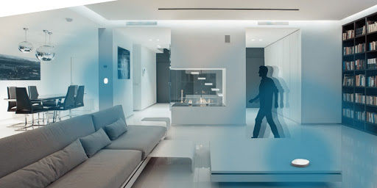
Motion Detection

Slide 8
Motion Detection Definition
Motion detection is the process of identifying regions in an image or video frame that exhibit movement or change over time.
It is useful for various applications, including surveillance, video analysis, and activity recognition.

Slide 9
Techniques for Motion Detection
1. Frame differencing: This technique involves subtracting consecutive frames to obtain a difference image. The resulting image highlights the pixels where significant changes occur. By applying thresholding, regions with notable differences are identified as moving objects.
2. Optical flow: Optical flow estimates the apparent motion of objects by analyzing pixel intensity variations between frames. Algorithms like Lucas-Kanade and Horn-Schunck calculate the motion vectors for each pixel, representing the direction and magnitude of movement.
3. Background subtraction: Background subtraction models and subtracts the static background to detect moving objects. Common techniques include Gaussian Mixture Models (GMM) and Adaptive Background Subtraction. The difference between the current frame and the background model reveals the regions with motion.

Slide 10
Challenges in Motion Detection
Several challenges can affect the accuracy of motion detection:
Lighting variations: Changes in lighting conditions can impact the accuracy of motion detection algorithms. Shadows, different lighting intensities, or abrupt changes in illumination can lead to false detections or missed motion.
Noise and artifacts: Presence of noise in the input frames or unwanted movements caused by factors like camera vibration can result in false detections.
Complex scenes: Scenes with cluttered backgrounds or multiple moving objects can make it difficult to accurately differentiate between the foreground (moving objects) and the background.
Camera motion: If the camera itself is moving, it can introduce false motion or complicate motion estimation. Camera motion needs to be compensated for accurate motion detection.
Occlusion: When an object is partially occluded by another object or by the environment, motion detection algorithms may struggle to detect the complete motion accurately.

Slide 11
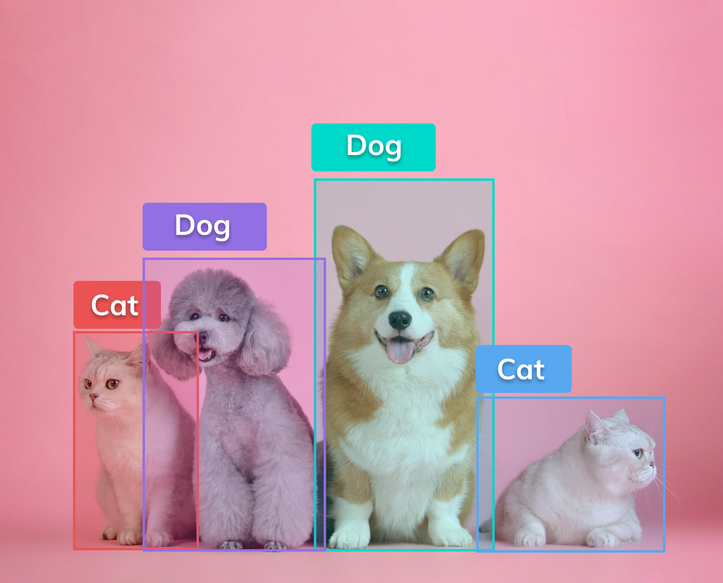
Detecting Objects with Pretrained Models

Slide 12
Introduction to Pretrained Models
Pretrained models are deep learning models that are already trained on large datasets, typically for object recognition tasks.
These models have learned to recognize objects and extract relevant features from images or video frames.
They can be used as a starting point for object detection tasks, saving time and computational resources.

Slide 13
Popular Pretrained Models for Object Detection
Several popular pretrained models are widely used for object detection:
1. Single Shot MultiBox Detector (SSD): SSD combines object localization and classification in a single network. It predicts a set of bounding boxes and their corresponding class probabilities for multiple object categories. SSD achieves real-time performance with high accuracy.
2. Faster R-CNN (Region-based Convolutional Neural Network): Faster R-CNN utilizes region proposals to identify potential object locations in an image. It extracts features using a convolutional neural network (CNN) and then uses these features to predict bounding boxes and class probabilities. Faster R-CNN achieves high accuracy but at the cost of increased computational complexity.
3. YOLO (You Only Look Once): YOLO divides the input image into a grid and predicts bounding boxes and class probabilities for each grid cell. It uses a single CNN pass to accomplish object detection. YOLO offers real-time object detection with good accuracy.

Slide 14
Workflow for Object Detection with Pretrained Models
The workflow for object detection with pretrained models typically involves the following steps:
1. Input preparation: Preprocess the input image or frame to meet the requirements of the pretrained model. This may include resizing, normalization, or other preprocessing steps.
2. Feeding the input to the pretrained model: Pass the preprocessed image or frame through the pretrained model to obtain predictions. The model processes the input using its learned weights and architecture.
3. Post-processing: Analyze the output from the pretrained model. This typically involves extracting bounding box coordinates, class labels, and confidence scores from the predictions. Applying a threshold to the confidence scores filters out weak detections.
4. Visualization or further analysis: The detected objects can be visualized by drawing bounding boxes and class labels on the original image or used for subsequent tasks such as tracking, segmentation, or recognition.

Slide 15
Fine-tuning Pretrained Models
Fine-tuning is the process of adapting a pretrained model to a specific object detection task using a smaller labeled dataset.
It involves training the pretrained model on the target dataset while updating the weights of some or all layers.
Fine-tuning helps improve the model's performance on domain-specific object detection challenges by leveraging the knowledge and features learned from the large-scale pretraining dataset.

